Slide 1

IU Outdoor Adventures
Robert Mulligan | Jeff Zhao | Blake Kohn | Philip Lapid | Alexandra Niebrugge
S307 Spring 2016 6876
Referential Corruption

Slide 2
What is IU Outdoor Adventures?
An outdoor recreation program serving Bloomington
For students and Bloomington residents
Offers gear, trips, and experiences
Rock climbing, backpacking, canoeing, etc.

Slide 3
Our goal for IU Outdoor Adventures
A database to automate and streamline processes
Store sales, vendors, equipment, classes, trips, and employee payroll
Link all aspects of the company operations

Slide 4
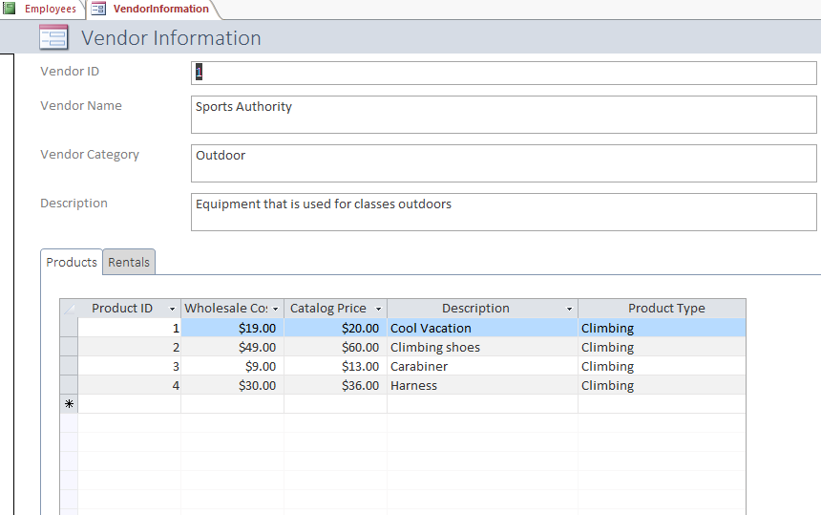
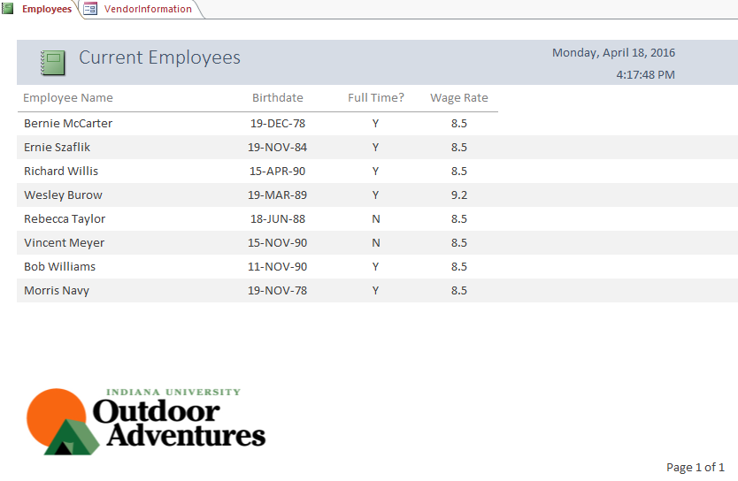
Examples of what this database can do

